Slide 1
Pump it Up: Data Mining the Water Table
A Classification Project
Andrew Rowan, Flatiron School

Slide 2

Problem Statement
There are over 56,000 water pumps in Tanzania and the challenge is to create a model that can accurately classify them into the one of the following:
Functional
Non Functional
Functional needs repair
Why?
Save on money, time and labor.
Ensure potable water is being provided to as many communities as possible
Fig. 1: Water Pump in Uwiro Village, Tanzania (credit Tom Murphy)

Slide 3
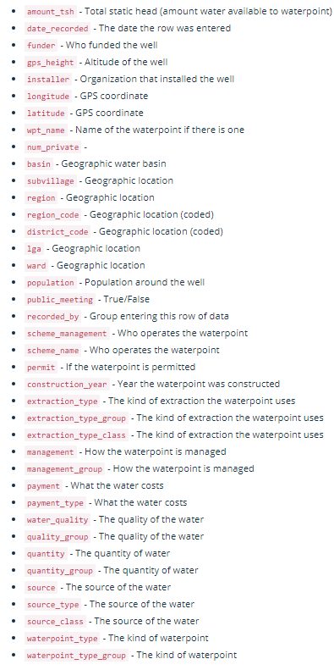
Data & Methods
Final Model
Logistic Regression
K-nearest neighbors
XGBoost
Decision Tree
Random Forest
Model evaluation, tuning and validation
Cleaning & Feature Engineering
CRISP-DM Process Model ³

Slide 4
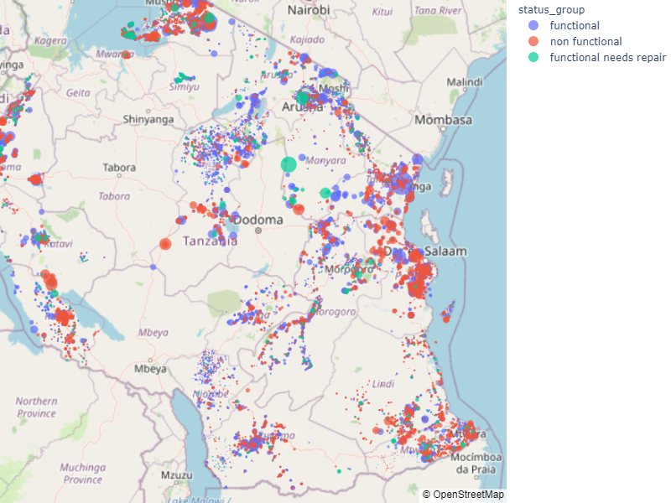
Tanzania Water Pumps
Relatively good spread on data.
Some regions with higher concentration of non-functional pumps.
Clearly location can matter…
Fig. 2: Water Pumps in Tanzania

Slide 5
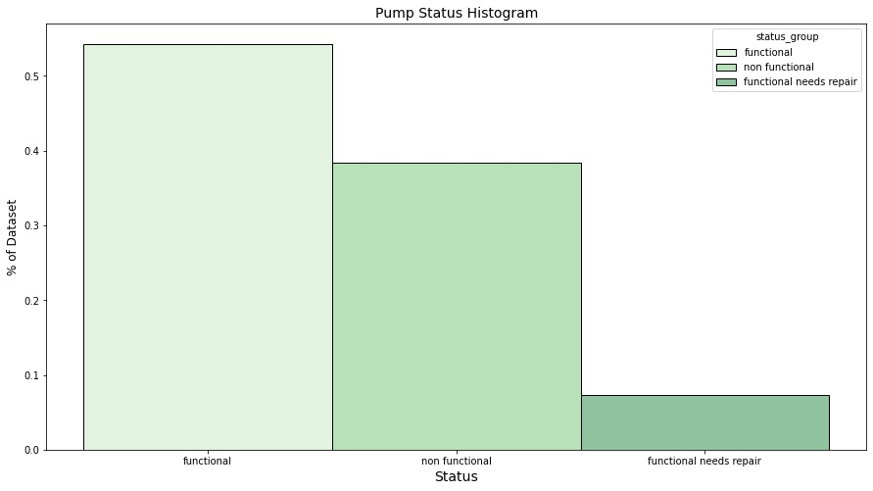
Class Imbalance

Slide 6
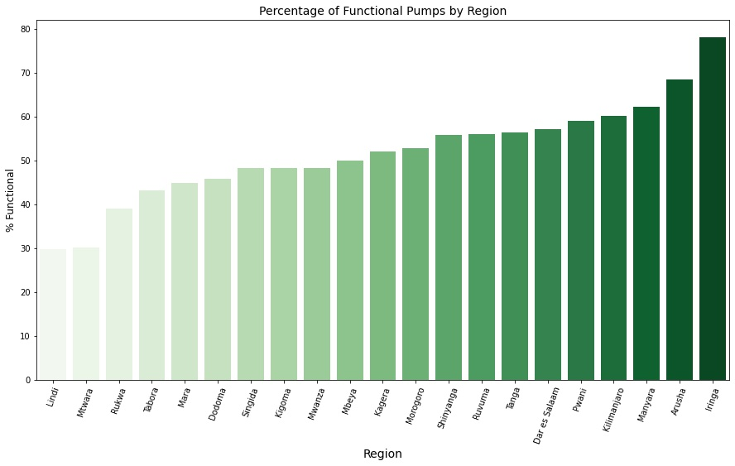
Functionality by Region

Slide 7
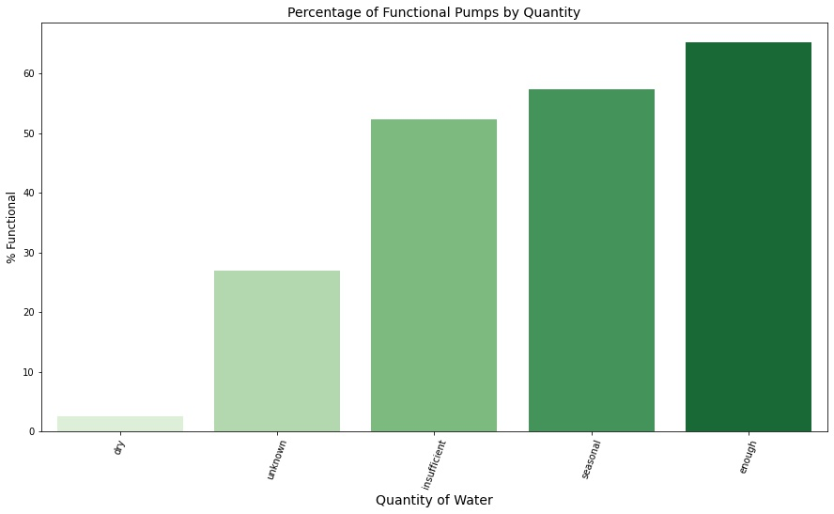
Functionality by Quantity of Water

Slide 8
Results - What will add Value?
Square Footage Total Living increase by 1: Sale Price increase by 119 USD
Adding bathroom could add 30,000 USD
Carrying out renovation adds 58,220 USD
Adding porch could add 17,560USD
Improving condition of house from Average to Good increases price by 33,950 USD
Fix the issues: A home sold with a problem such as water issue will sell for 18,960 USD less than one without

Slide 9
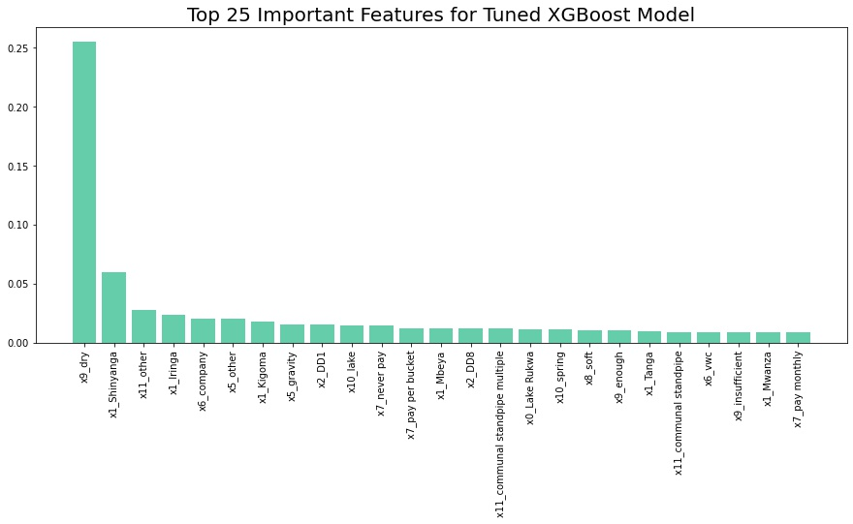
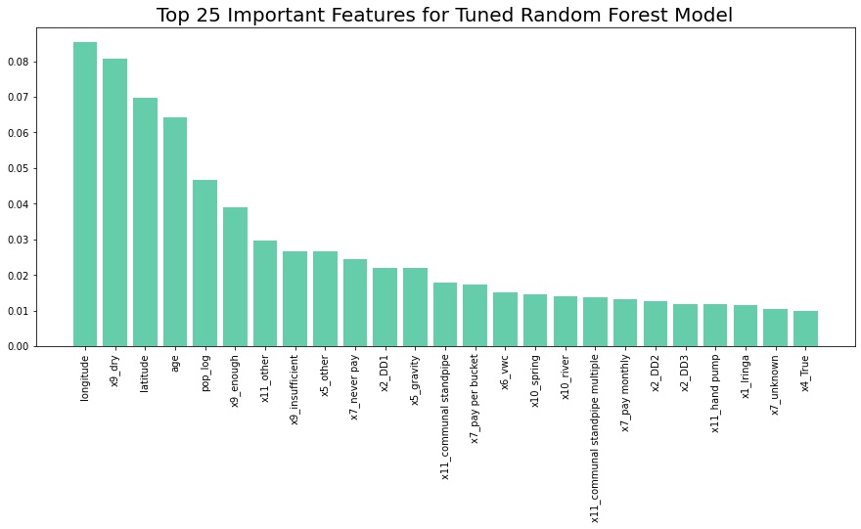
Feature Importance
On the two best performing models, an important feature was quantity, and in particular when one hot encoded X9_dry. Random Forest appears to have more intuitive importances: age, location, population.

Slide 10
Conclusion – What does it all mean?
Whilst the model explained 83.5% of the variance in sale price, it performed worse in more expensive properties.

Slide 11
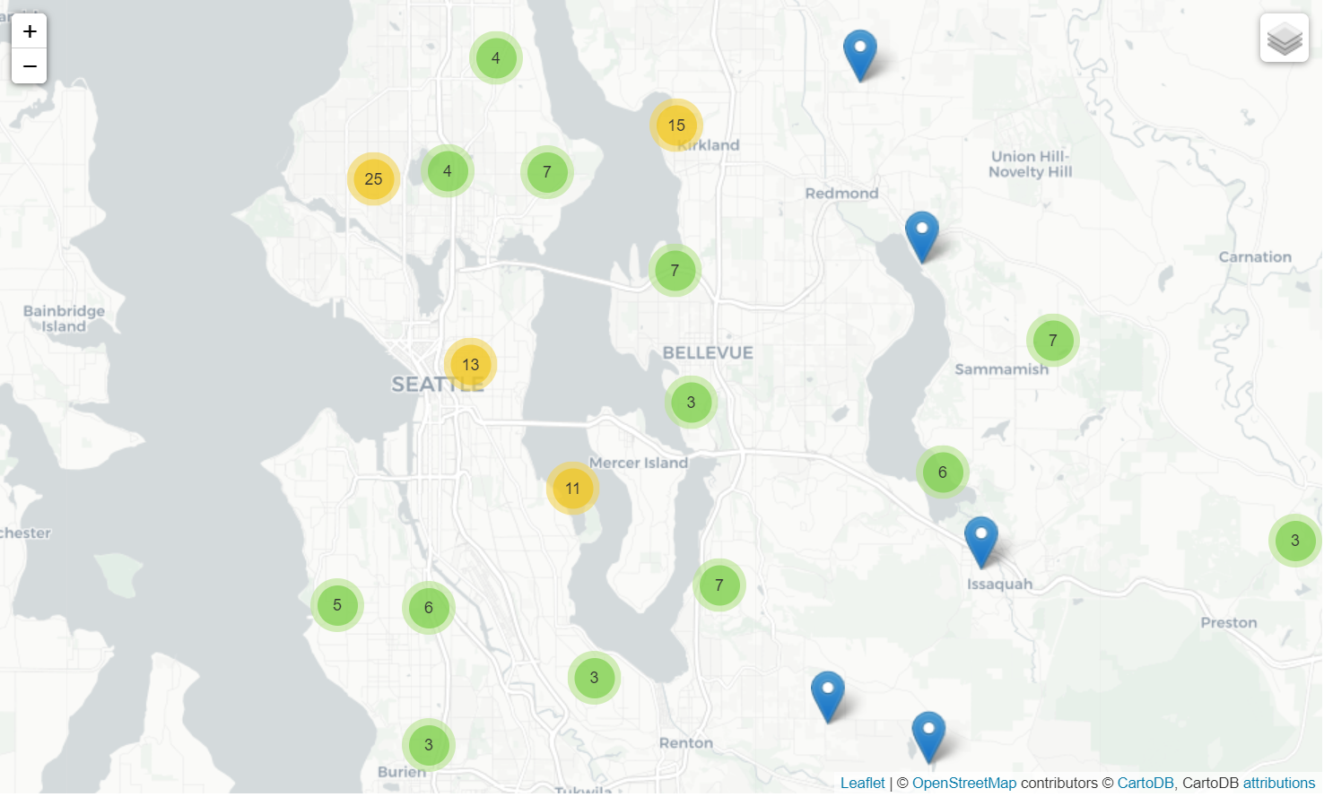
Conclusion - Further Work
By mapping top 200 locations where difference between model and actual was the largest, it can be seen that the model underestimates price very close to water.

Slide 12
Future Improvements
Make use of high cardinality features somehow – perhaps binning.
Utilise cloud computing to expand the parameters of RandomizedsearchCV
Source external data, rainfall data, maintenance records
Are dry pumps really not functional?

Slide 13
Thank You!
Email: adrowan88@gmail.com

